Slide 1
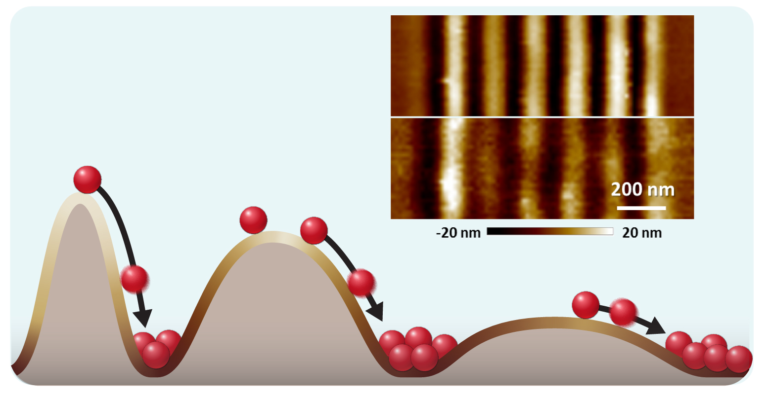
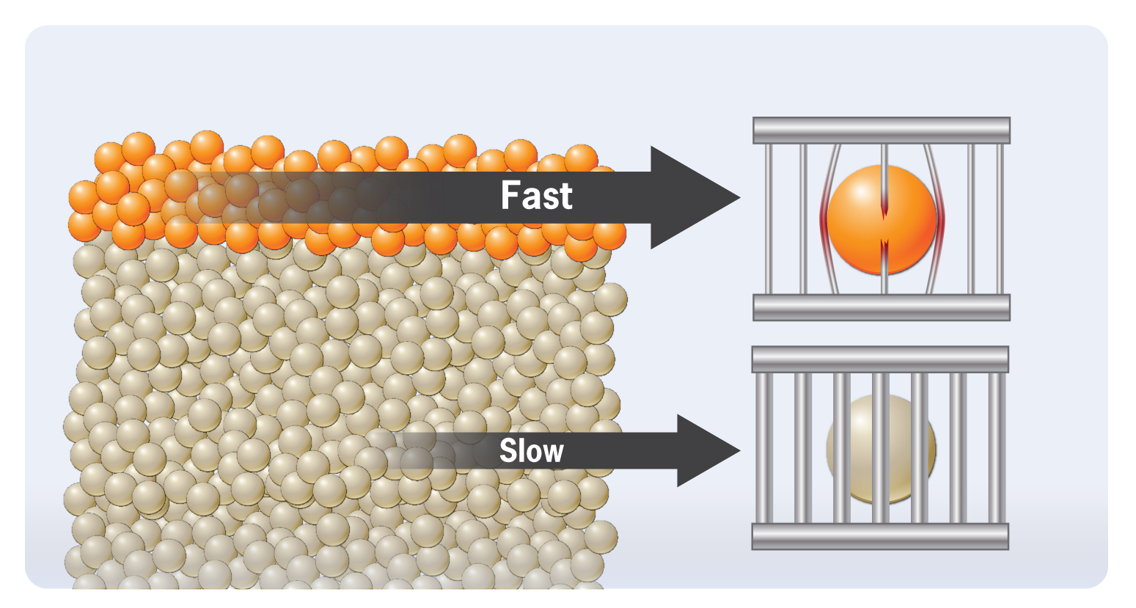
New insights into surface diffusion on glasses
Materials Research Science and Engineering Centers, DMR-1720415
IRG 1, 2020
Lian Yu, Dane Morgan, John Perepezko, Paul Voyles, Mark Ediger, University of Wisconsin-Madison
Understanding how atoms move is fundamental to making and using materials. Atoms on the surface of some glasses move at nearly the same rate as atoms on the inside. But for other glasses, surfaces atoms move a million times faster. Researchers in the Wisconsin MRSEC IRG 1 have combined experiments, simulations, and data-centric methods to understand why some surfaces are so much faster than others.
They found that atoms in glasses move by breaking out of a “cage” of nearby atoms. On the surface, that cage can be weaker than inside the glass, allowing for faster motion. They also discovered a relationship that predicts surface motion from more accessible data about bulk motion. Their results unify behavior for glasses of organic molecules, metals, and oxides and make creating glasses for applications like light-emitting diodes, quantum computers, and hard coatings easier.
Figure 1: Grating decay method for measuring surface mobility of atoms. The IRG has applied this technique to organic, metallic, and covalently bonded glasses.
Figure 2: Molecules move faster on glass surfaces than inside the glass, but the way they push past each other is similar.
A. Annamareddy, Y. Li, L. Yu, P. M. Voyles, D. Morgan, "Factors Correlating to Enhanced Surface Diffusion in Metallic Glasses." J. Chem. Phys. 154, 104502 (2021)
C. R. Cao, L. Yu, J. H. Perepezko, "Surface Dynamics Measurement on a Gold Based Metallic Glass." App. Phys. Lett. 116, 231601 (2020)
J. Barták, J. Málek, K. Bagchi, M. D. Ediger, Y. Li, L. Yu, "Surface Mobility in Amorphous Selenium and Comparison with Organic Molecular Glasses." J. of Chem. Phys. 154, 074703 (2021).
Notes:
The IRG has made extensive measurements and simulations of surface diffusivity in glasses, primarily near the glass transition temperature T_{g}. Experiments using the Mullins grating decay method have been widely used by the IRG to study surface diffusion on molecular glasses. Those methods have been transferred to IRG members working on metallic glasses and applied and extended through collaboration to measure surface diffusivity on covalently bonded glasses. These results show dramatically enhanced surface diffusivity for metallic glasses and selenium compared to bulk diffusion at the same temperature, although the enhancement is smaller than it is for some molecular glasses.
Simulations using molecular dynamics on several metallic glass compositions with EAM potentials were used to gain atomic-level insight into the factors governing diffusion. Diffusion in glasses in the bulk at low temperature proceeds by cage breaking and hopping. The IRG showed that surface diffusion occurs by the same fundamental mechanisms, and that the difference lies primarily in the energy barrier for cage breaking, rather than the energy barrier for hopping or the attempt frequency.
The IRG has combined all these results from experiments and simulations across organic and inorganic glasses with other surface diffusivity data from the literature to show a relationship between the ratio of surface to bulk diffusivity at T_{g} with the bulk fragility of the glass-forming liquid. The more fragile the liquid, the higher the surface diffusivity compared to the bulk. This relationship is a useful tool for materials design, as bulk fragility data are available for many more compositions than surface diffusivity data, but it also points to a deep commonality between the underlying fundamental motions of molecules on the surface and in the bulk. This commonality may be the similarity of cage breaking observed for metallic glasses, but more research is needed to test this hypothesis.
In addition to the two papers listed on the highlight, the highlight draws from the following MRSEC-supported publications:
Li, Y. H., W. Zhang, C. Bishop, C. B. Huang, M. D. Ediger, L. Yu. 2020. "Surface Diffusion in Glasses of Rod-Like Molecules Posaconazole and Itraconazole: Effect of Interfacial Molecular Alignment and Bulk Penetration." Soft Matter 16, 5062-5070 (2020)
A. Annamareddy, P. M. Voyles, J. Perepezko, D. Morgan “Mechanisms of bulk and surface diffusion in metallic glasses determined from molecular dynamics simulations” Act. Mat. 209, 116794 (2021).
More information about the figures:
Figure 1: Schematic image showing way atoms move from high energy to peaks to low energy valleys which leads to smoothing of initial grating. Smoothing rates can be used to extract surface diffusion rates by the Mullins surface grating decay method. Smoothing rates are measured by analyzing changes in amplitudes from AFM images like that shown here, which gives the pattern at 0 s (top) and 3.5×10⁵ s (bottom) for a 150 nm surface grating on a Au₆₀Cu_{15.5}Ag_{7.5}Si₁₇ metallic glass.
Figure 2: Schematic showing the cage breaking mechanism that dominates bulk and surface diffusion in metallic glasses, with weaker cages allowing for faster hopping at surfaces.

