Slide 1
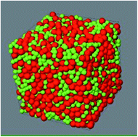
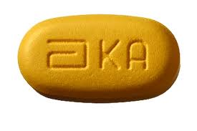
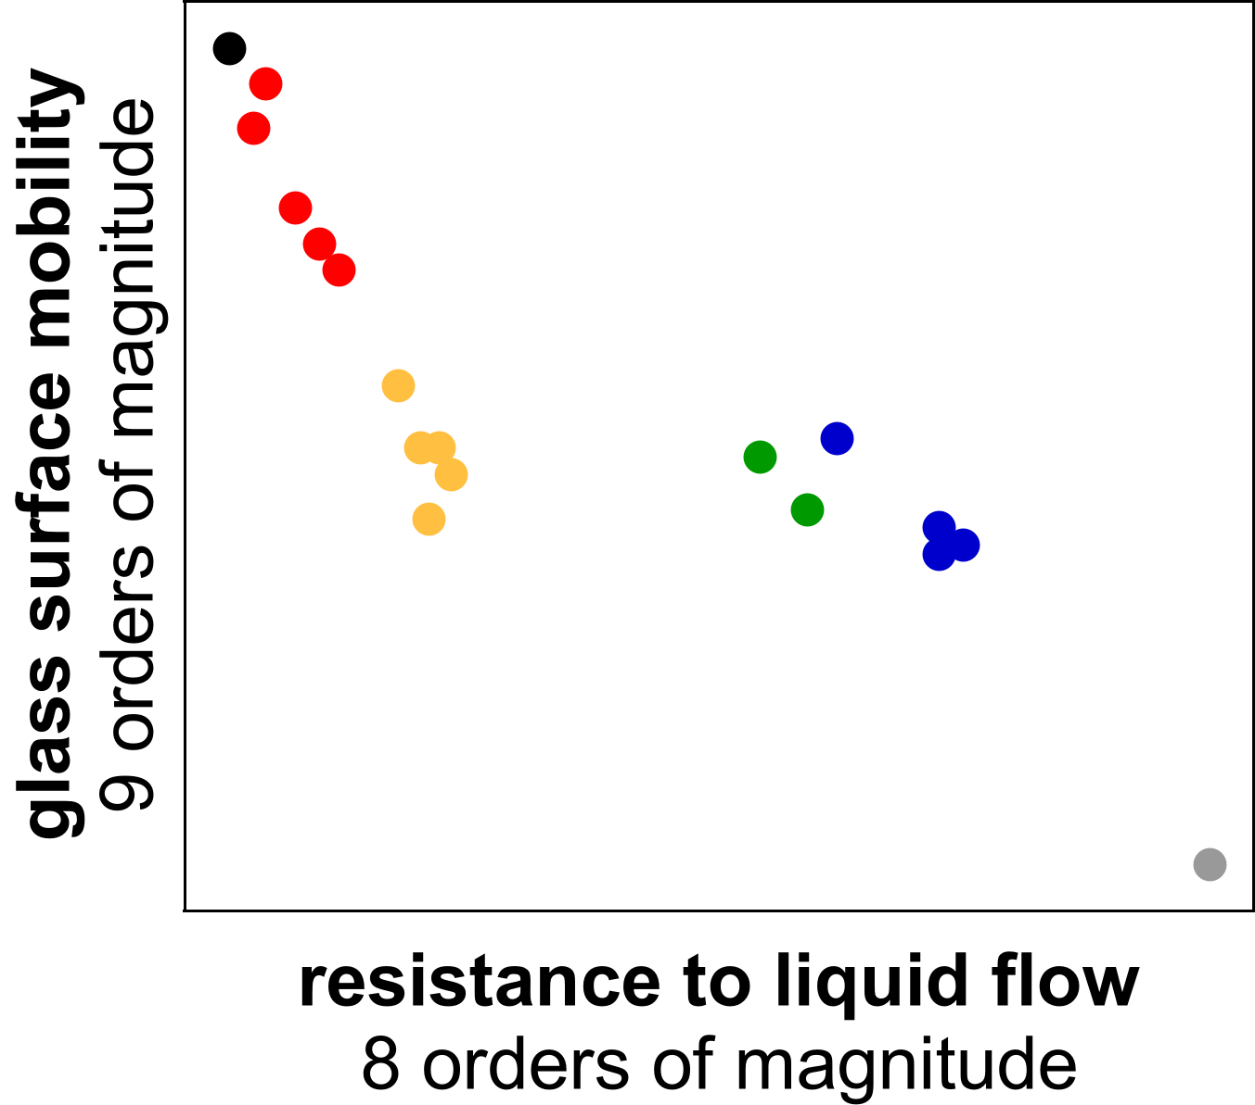
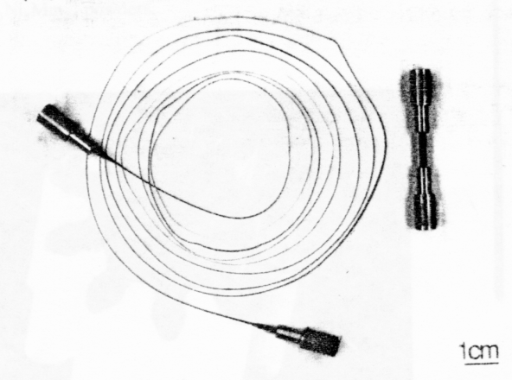
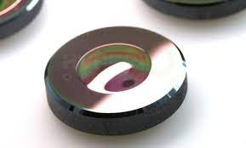
Wisconsin MRSEC
DMR-1720415
A New Common Behavior for Glasses
L. Yu, D. Morgan, P. Voyles, M. Ediger, J. Perepezko, U. Wisconsin-Madison
Materials scientists use rules that hold across different kinds of materials as powerful tools to understand material’s fundamental behavior, to predict their properties and performance, and to design new materials.
Wisconsin MRSEC researchers have discovered a new common behavior for glasses: How fast atoms move on a glass surface is connected to how easily flow is activated for the same material as a liquid. This connection holds across all kinds of glasses and over many orders of magnitude in the speed of motion.
The connection lets scientists predict surface mobility, which is rarely measured, from liquid flow data, which is much more common. The fabrication of glasses by vapor deposition and their properties in thin film form, as they are used in cell phone displays, photovoltaics, and coatings, depends on their surfaces, so the connection is an important practical tool for glass materials design. It also points to deep, fundamental connections to how molecules move at solid glass surfaces and inside liquids, which is the topic of ongoing research.
simulated glass
molecular glass
polymer glass
metallic glass
covalent glass
chalcogenide glass
Notes:
What Has Been Achieved: The IRG has demonstrated a correlation between surface diffusivity on a glass at the glass transition temperature, T_{g}, and the viscosity of the corresponding liquid at 1.25T_{g}, which is used as a proxy for the liquid fragility. (Fragility is related to the slope of the viscosity with temperature approaching T_{g}.) This correlation holds for the Kob-Anderson simulated glass, various molecular glasses, glassy polymers of various molecular weights, several metallic glasses, and several covalently bonded glasses. This discovery was only possible with the combined efforts of five IRG investigators with expertise in molecular glasses, polymeric glasses, metallic glasses, oxide glasses, and simulations.
Importance of the Achievement: The correlation points to a fundamental connection between glass surface dynamics and bulk, supercooled liquid dynamics, potentially arising from the underlying molecular motions. The correlation also serves as a useful practical tool: Surface mobility at T_{g} is essential to synthesizing ultrastable and anisotropic glasses via physical vapor deposition (PVD), but surface diffusivity have been measured for only a handful of glasses. Bulk viscosity or calorimetric fragility is available for a much larger list of compositions. Thus, predicting surface mobility from bulk viscosity data enables materials selection and design for glass thin films with useful properties.
How is the achievement related to the IRG, and how does it help it achieve its goals? One of the goals of IRG 1 is to create ultrastable and other unusual glasses using PVD, so understanding surface diffusivity is essential. This finding advances our understanding of surface diffusion and our ability to synthesize unusual new glasses by PVD. In addition, the IRG exists to bring together organic and inorganic glass scientists to cross-pollinate ideas and results from these two often disconnected communities. This finding is a testament to the power of that interdisciplinary approach. It would not have been possible without the IRG.
Where the findings are published: Li, Y., Annamareddy, A., Morgan, D., Yu, Z., Wang, B., Cao, C., Perepezko, J. H., Ediger, M. D., Voyles, P. M. & Yu, L. Surface Diffusion Is Controlled by Bulk Fragility across All Glass Types. Phys Rev Lett 128, 075501, (2022). DOI: 10.1103/PhysRevLett.128.075501

