Slide 1
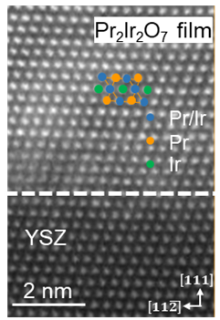
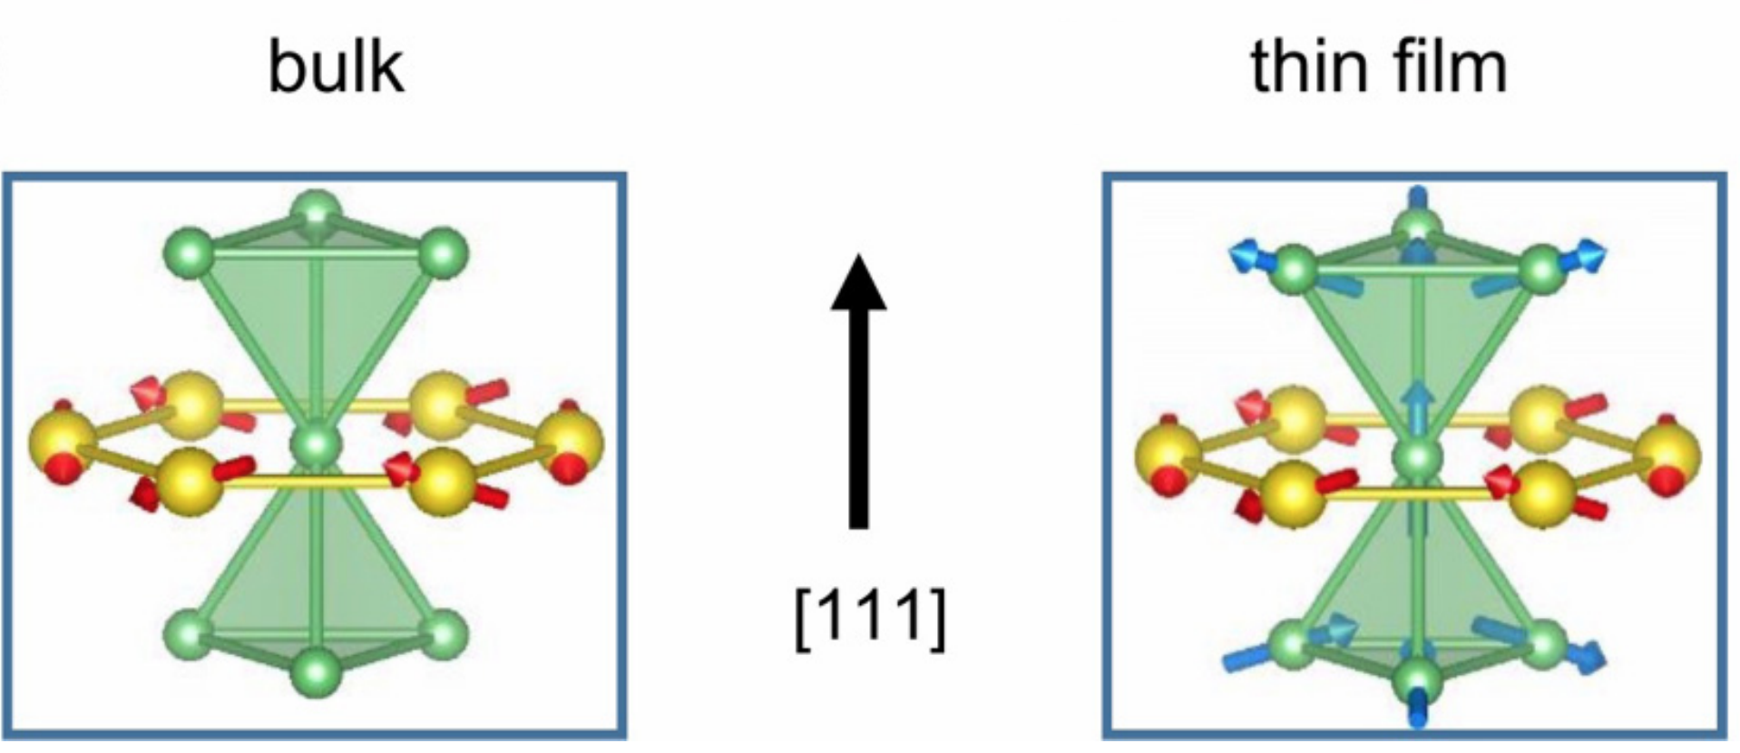
Solid-phase epitaxy produce magnetic oxides with novel magnetic properties
Materials Research Science and Engineering Centers, DMR-1720415
2020 IRG 2 Intellectual Merit
Chang-Beom Eom, University of Wisconsin-Madison
The magnetism of materials arises from magnetic moments associated with particular atoms. A magnetic moment is a bit like a tiny bar magnet. If all the moments point in the same direction, the material behaves like a permanent magnet, but there are many other possible arrangements with different behaviors.
The Wisconsin MRSEC has created thin films of a fascinating magnetic material, Pr₂Ir₂O₇, in which the magnetic moments are frustrated: No matter how they are arranged, some of the moments are always fighting to change their direction, like two bar magnets with their north poles shoved together. Frustration creates a rich landscape for discovery and manipulation of new magnetic effects and of electronic phenomena linked to magnetism.
The Pr₂Ir₂O₇ was synthesized by solid-phase epitaxy, a process in which a structurally disordered, amorphous layer is transformed into an ordered crystal. This synthesis method avoids evaporation of iridium during crystal growth, which limits synthesis by conventional methods. A key feature of the thinness of the films is that they are stretched during growth, which provide further control of their magnetic properties.
Epitaxial iridate synthesis
Novel magnetic properties in thin films
L. Guo, et al., “Spontaneous Hall effect enhanced by local Ir moments in epitaxial Pr₂Ir₂O₇ thin films,” Phys. Rev. B 101, 104405 (2020). DOI: 10.1103/PhysRevB.101.104405
Notes:
Rare earth (RE) pyrochlore iridates (RE2Ir2O7) consist of two interpenetrating cation sublattices, the RE with highly frustrated magnetic moments, and Ir with extended conduction orbitals significantly mixed by spin-orbit interactions. The coexistence and coupling of these two sublattices create a landscape for discovery and manipulation of quantum phenomena such as the topological Hall effect, massless conduction bands, and quantum criticality. Epitaxial thin films allow extended control of the material system via symmetry-lowering effects such as strain. To stabilize Pr2Ir2O7, the Wisconsin MRSEC has used solid-phase epitaxy (SPE) to fabricate epitaxial thin films. Epitaxial thin films on yttria-stabilized ZrO2 (YSZ) (111) substrates synthesized via SPE exhibit a spontaneous hysteretic Hall effect at temperatures up to 15 K, compared to less than 1.5K in bulk form. Synchrotron-based element-specific x-ray diffraction and x-ray magnetic circular dichroism were used to compare powders and thin films and attribute the spontaneous Hall effect in the films to localization of the Ir moments. The elevated-temperature spontaneous Hall effect originates from topological effects in either the Ir or Pr sublattice, with interaction strength enhanced by the Ir local moments. This spontaneous Hall effect with weak net moment highlights the effect of small lattice distortions as a means to discover topological phenomena in metallic frustrated magnetic materials.

