Slide 1
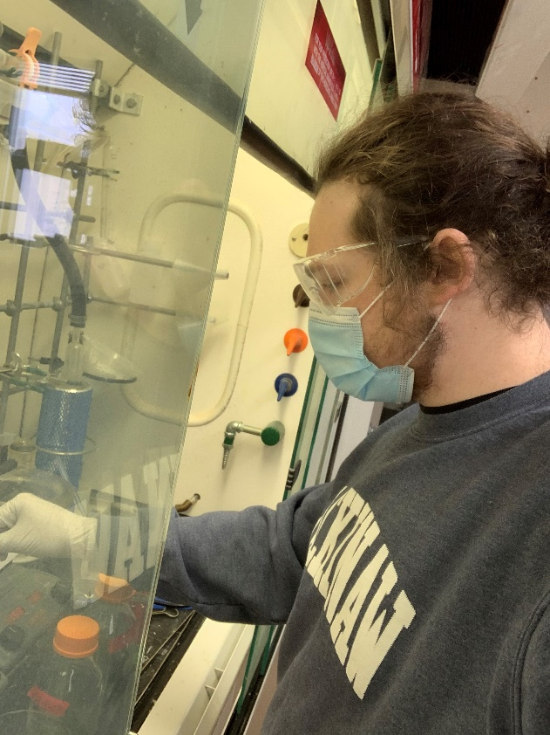
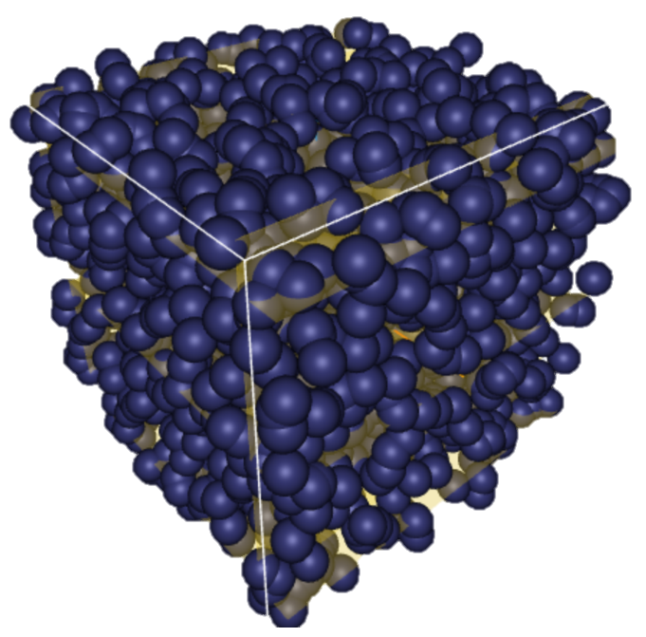
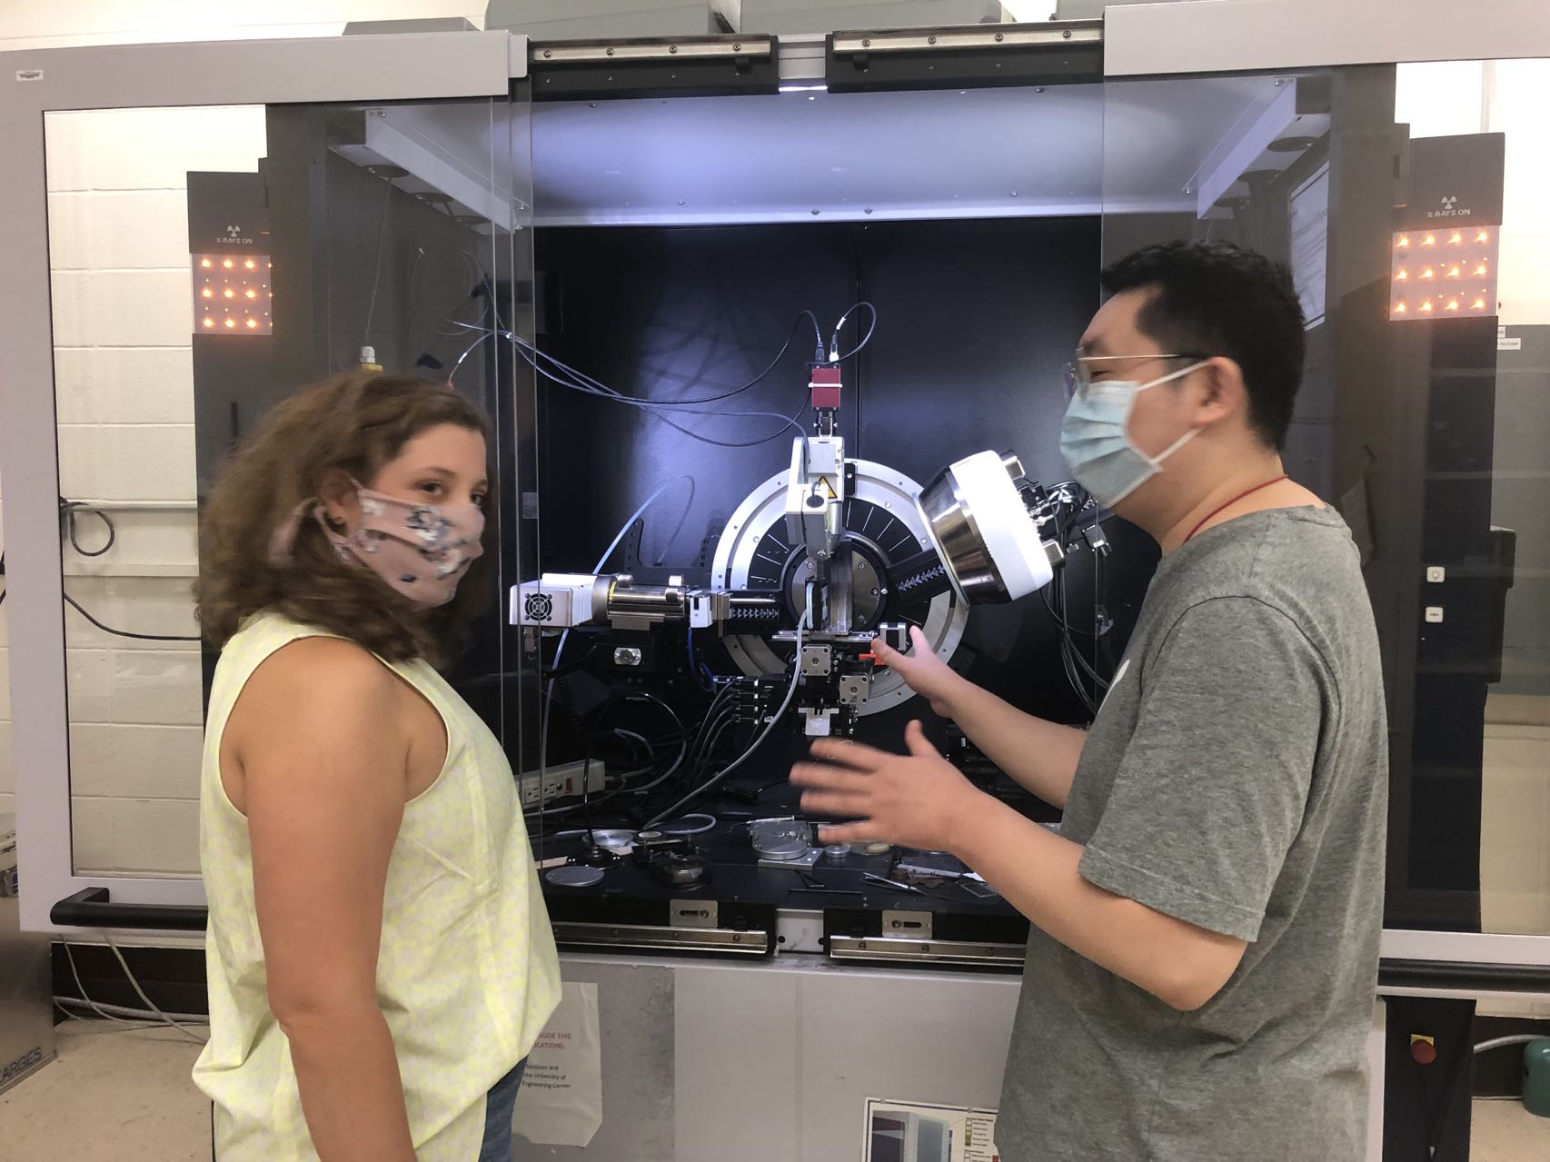
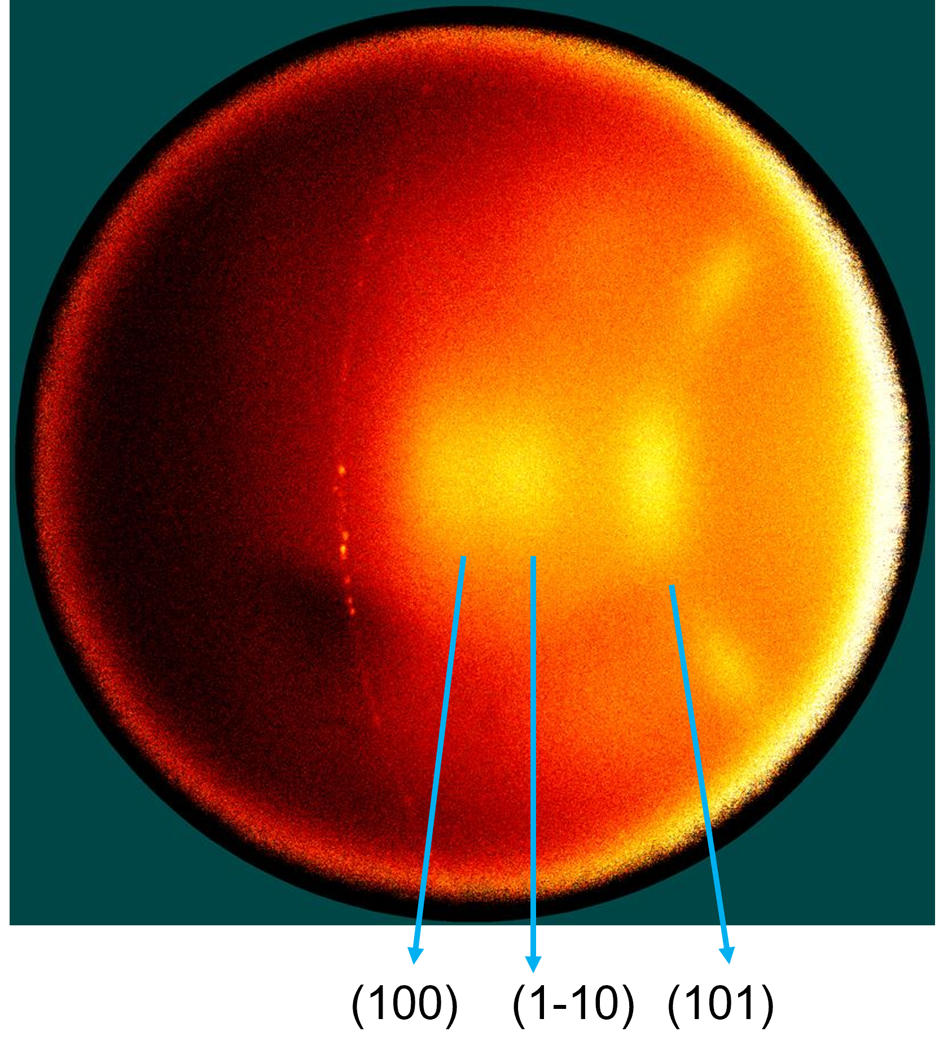
Student-Industry Seed Projects Teach Essential Skills for Future Success
Materials Research Science and Engineering Centers, DMR-1720415
Industrial Engagement, 2021
Brandon Hacha (U. Wisc), Momchil Minkov (FlexCompute, Inc.), Rui Liu (U. Wisc), Kevin Nelson (Amcor, Inc.)
Preparing students for careers inside and outside academia is a key mission for the Wisconsin MRSEC and its Advanced Materials Industrial Consortium (AMIC). AMIC sponsors student-led seed research projects to help students learn essential skills. AMIC companies suggest project areas, then company engineers work with MRSEC students to develop research proposals that leverage the student’s expertise. The AMIC Board selects projects, and students lead the resulting research, managing the budget, junior personnel like undergraduates, and reporting. Company engineers mentor the student leaders.
This year’s projects were led by Brandon Hacha, who simulated lasing from random media in 3D in with Momchil Minkov from FlexCompute, and by Rui Liu, who used x-ray diffraction to characterize polymers for recyclable packaging with Kevin Kevin Nelson from Amcor. The students and their mentors reported that the students gained new skills in project management and an appreciation for industrial R&D from the experience.
simulated lasing
random medium
Brandon Hacha
Riu Liu and Marlee Newman
x-ray diffraction data

