Slide 1
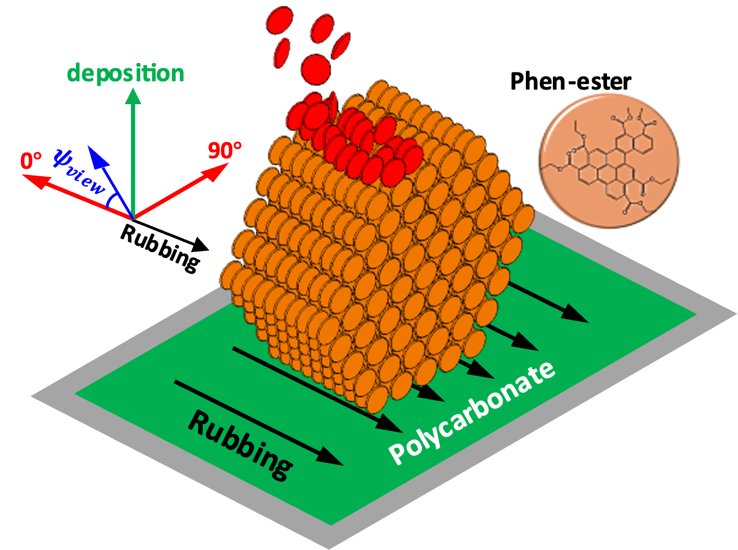
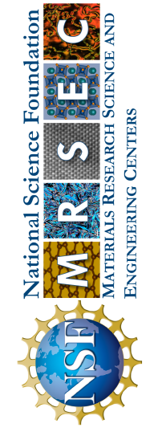
Wisconsin MRSEC
DMR-2309000
Biaxially-aligned Glasses of Organic Semiconductors
Paul Voyles and Mark Ediger, University of Wisconsin-Madison
While most glassy materials are formed by cooling a liquid, glasses can also be prepared by depositing molecules from the vapor phase directly into a solid film. This vapor deposition process is used with organic semiconductors to produce organic light emitting diode (OLED) displays which are found in most smart phones. OLED glasses are anisotropic: their molecules are aligned, instead of pointing in random directions. Anisotropy increases the display efficiency.
Researchers in the Wisconsin MRSEC have shown that depositing onto an alignment substrate creates better glass films that are anisotropic biaxially, meaning they are aligned in the plane of the substrate as well as out of plane. The in-plane orientation of the molecules effect how they interact with light and conduct electricity. In general, more alignment is better for applications ranging from flexible transistors to OLEDs to organic photovoltaics.
Wisconsin MRSEC researchers deposited an organic semiconductor (Phen-ester, represented by small disks) from the vapor, onto an alignment substrate of rubbed polycarbonate to produce a biaxially anisotropic glass.
Notes:
What Has Been Achieved: Wisconsin MRSEC researchers used physical vapor deposition (PVD) to prepare thin films of an organic semiconductor, phenanthroperylene ester or Phen-ester. While PVD has previously been shown to produce glasses with uniaxial anisotropy out of plane with respect to the substrate, use of a substrate with a preferred direction (produced by rubbing) results in a biaxially-anisotropic glass. The deposited structure is similar to that of a columnar liquid crystal monodomain. Since the substrate temperature is low, the deposited material is kinetically trapped in a nonequilibrium state, and thus is properly described as a glass.
Importance of the Achievement: For organic semiconductors like phenanthroperylene ester, molecular orientation controls light emission and absorption, and is likely to play a significant role in charge mobility. Controlling in-plane orientation should enable control over those properties using industry-standard PVD methods and at temperatures more than 100 K lower than the temperatures required to create large, oriented liquid-crystal domains through annealing alone.
How is the achievement related to the IRG, and how does it help it achieve its goals? IRG 1 seeks to use the enhanced mobility at the surface of a glass during PVD to access new glass states. Highly oriented glasses like the materials studied here push our understanding of glassy materials by being very strongly structurally ordered, but still exhibiting a glass transition on heating. Understanding and controlling how they grow is a step on the path to creating and defining the limits of glassy materials, engineering new glass structure / property relationships, and deeper understanding of the glass state in general.
Where the findings are published: J. Ju, D. Chatterjee, P.M. Voyles, H. Bock, and M.D. Ediger, Vapor-to-glass preparation of biaxially aligned organic semiconductors, Journal of Chemical Physics (Communication) 159, 211101 (2023); https://doi.org/10.1063/5.0174819

