Slide 1
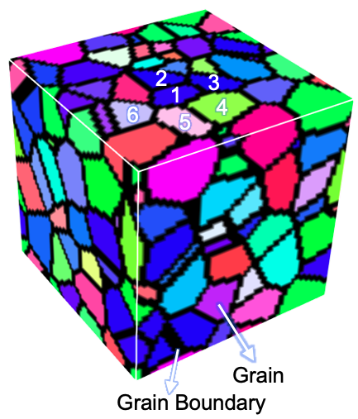
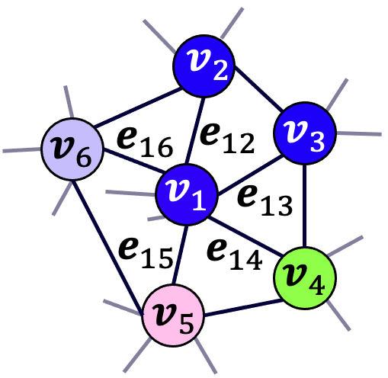
Wisconsin MRSEC
DMR-2309000
Graph Machine Learning for Polycrystals
Jiamian Hu, University of Wisconsin-Madison
Polycrystalline materials are everywhere in everyday life, but their microstructure – the arrangement of atoms into crystal grains and grains into a piece of material – covers 10 orders of magnitude in size and involves millions important features. This complexity makes it extremely difficult for scientists to predict the properties of polycrystalline materials quickly and accurately.
Wisconsin MRSEC researchers have leveraged the power of machine learning to tame the complexity of polycrystalline materials and predict their properties. They have developed a graph neural network approach that predicts materials properties with >98% accuracy 90,000 times faster than competing methods. They applied this model to predict magnetostriction, which quantifies the size change of a material induced by a magnetic field. Development and design of high magnetostriction materials will enable MRSEC researchers to efficiently control magnetism using mechanical force and enable future technologies such like magnetic soft robots.
Edge
Node
A 3D polycrystalline microstructure model with 133 grains.
A section of the graph encoding this microstructure with 6 nodes and 5 edges. Each node represents a grain and each edge represents a grain boundary.
Notes:
What Has Been Achieved: We have developed a graph neural network (GNN) model that enables a fast and accurate (>98%) prediction of the effective properties of polycrystalline materials. The model is directly applicable to 3D microstructure datasets obtained (for example) from electron backscatter diffraction (EBSD).
Importance of the Achievement: Our rigorous baseline study unambiguously demonstrated the high accuracy of our GNN model. Our comprehensive feature selection study provides an example of addressing one of the central questions in the application of GNN, that is, how to decide which feature to use for each node (grain) or each edge (grain boundary)? The protocols we developed for harnessing practical 3D EBSD data would be of interests to many peer researchers in both academia and industry.
How is the achievement related to the IRG, and how does it help it achieve its goals? The GNN model we developed can be readily extended to all of the types of magnetic materials that are being developed in IRG2, especially the magnetic shape memory alloys with coexistence of complex martensitic domain and magnetic domain structures, because graph is now one of the mainstream methods for representing both the atomistic crystal structure and the microstructure. There may also be useful interactions with graph-based machine learning efforts in IRG 1.
Where the findings are published: M. Dai, M. F. Demirel, X. Liu, Y. Liang, and J.-M. Hu, Graph neural network for predicting the effective properties of polycrystalline materials: A comprehensive analysis, Computational Materials Science, 230, 112461 (2023). https://doi.org/10.1016/j.commatsci.2023.112461

