Slide 1
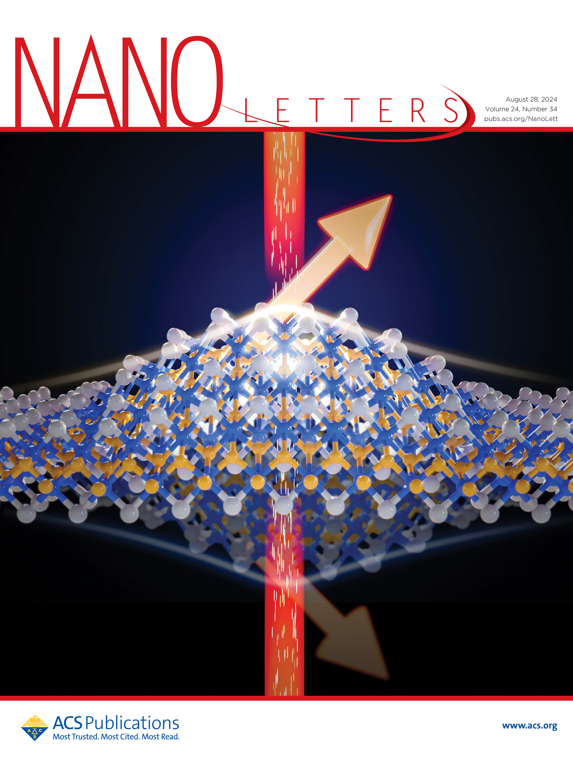
Wisconsin MRSEC
DMR-2309000
Spin-Mechanical Coupling in 2D Antiferromagnet CrSBr
Yuan Ping, Ying Wang, and Jun Xiao, University of Wisconsin-Madison
Wisconsin MRSEC researchers have demonstrated that strain can dramatically alter the magnetoelastic properties of a two-dimensional material, CrSBr. Magnetoelasticity is the interaction between magnetism and strain. The researchers developed a nanoscale mechanical resonator device to measure the material’s magnetoelastic coupling. Using it, they showed that 2D CrSBr has a particularly large coupling, and that it can be tuned by 50% by stretching the 2D membrane.
These results demonstrate a new way to modify magneto-mechanical properties via strain and pave the way for high-sensitivity magnetic sensing, energy-efficient electronics, and strain-tunable quantum information transduction.
Image of a CrSBr mechanical resonator. A thin CrSBr flake (white dashed line) is suspended over an etched circular trench as a resonator
Strong coupling between spins/magnetism (red arrows) and mechanical strain in a vibrating CrSBr membrane.
Notes:
What Has Been Achieved: IRG 2 researchers have used nano-mechanical resonators to mechanically detect the phase transition and magnetostriction effect in 2D antiferromagnet CrSBr. The transitions among antiferromagnetism, spin-canted ferromagnetism, and paramagnetism were visualized. A large magnetostriction coefficient 2.3 × 10⁻⁵ and a magnetoelastic coupling strength on the order of 10⁶ J/m³ were found. Gate-induced strain of the CrSBr membrane tuned the magnetoelastic constant by nearly 50%.
Importance of the Achievement: This research demonstrates strong spin-mechanical coupling in CrSBr, which paves the way for developing sensitive magnetic sensing and efficient quantum transduction at the atomically thin limit with large strain tunability. The nanomechanical device technology developed here has already been used to explore other strain-dependent phenomena in 2D materials.
How is the achievement related to the IRG, and how does it help it achieve its goals? This study experimentally demonstrates one of the key goals of IRG 2: strain-tuning of magnetism and magnetic properties. It shows strain-tuning of spin-mechanical coupling in 2D magnetic materials. Moreover, the nano-opto-mechanical method developed here enables precise measurement of thermodynamic and magneto-mechanical properties in nanoscale membranes, which can not be achieved by conventional methods developed for bulk crystals. These findings will enable future IRG research on strain tunable spin excitations and ultrafast magnetic phase transitions.
Where the findings are published: Fan Fei, Yulu Mao, Wuzhang Fang, Wenhao Liu, Jack P. Rollins, Aswin L. N. Kondusamy, Bing Lv, Yuan Ping, Ying Wang, and Jun Xiao Nano Letters 2024 24 (34), 10467-10474 DOI: 10.1021/acs.nanolett.4c01751

