Slide 1



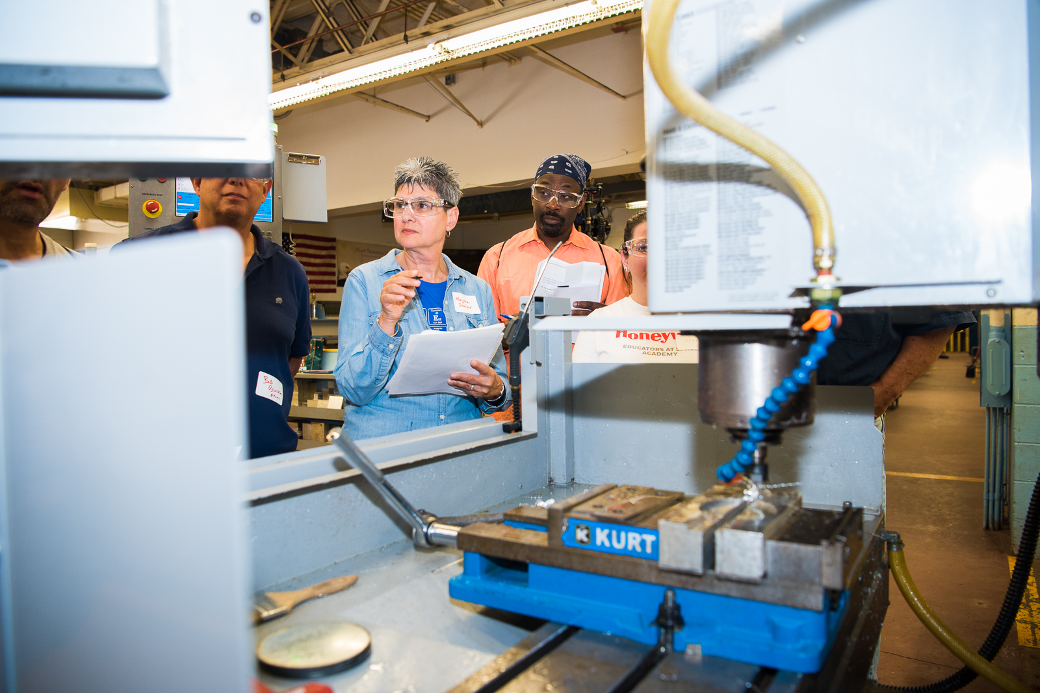
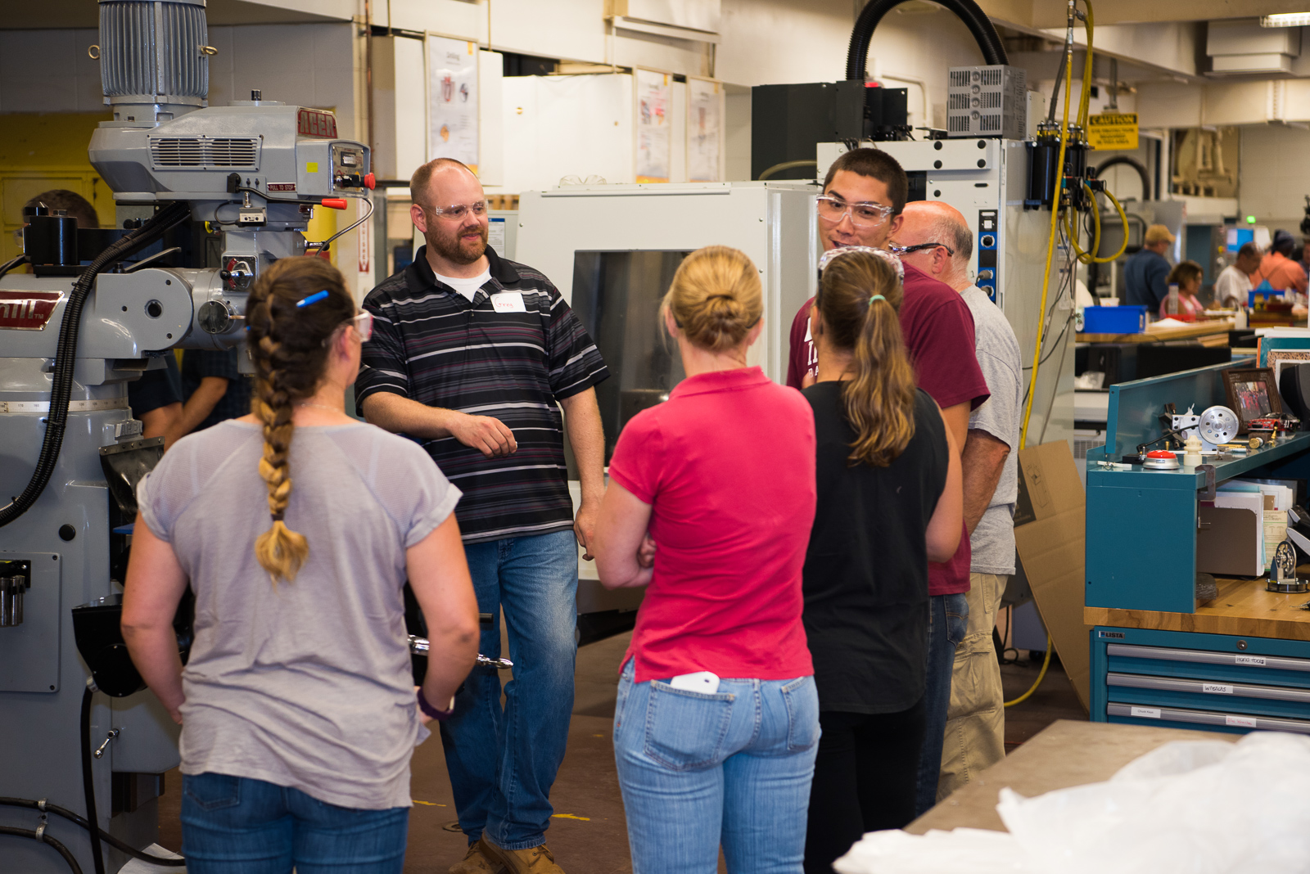
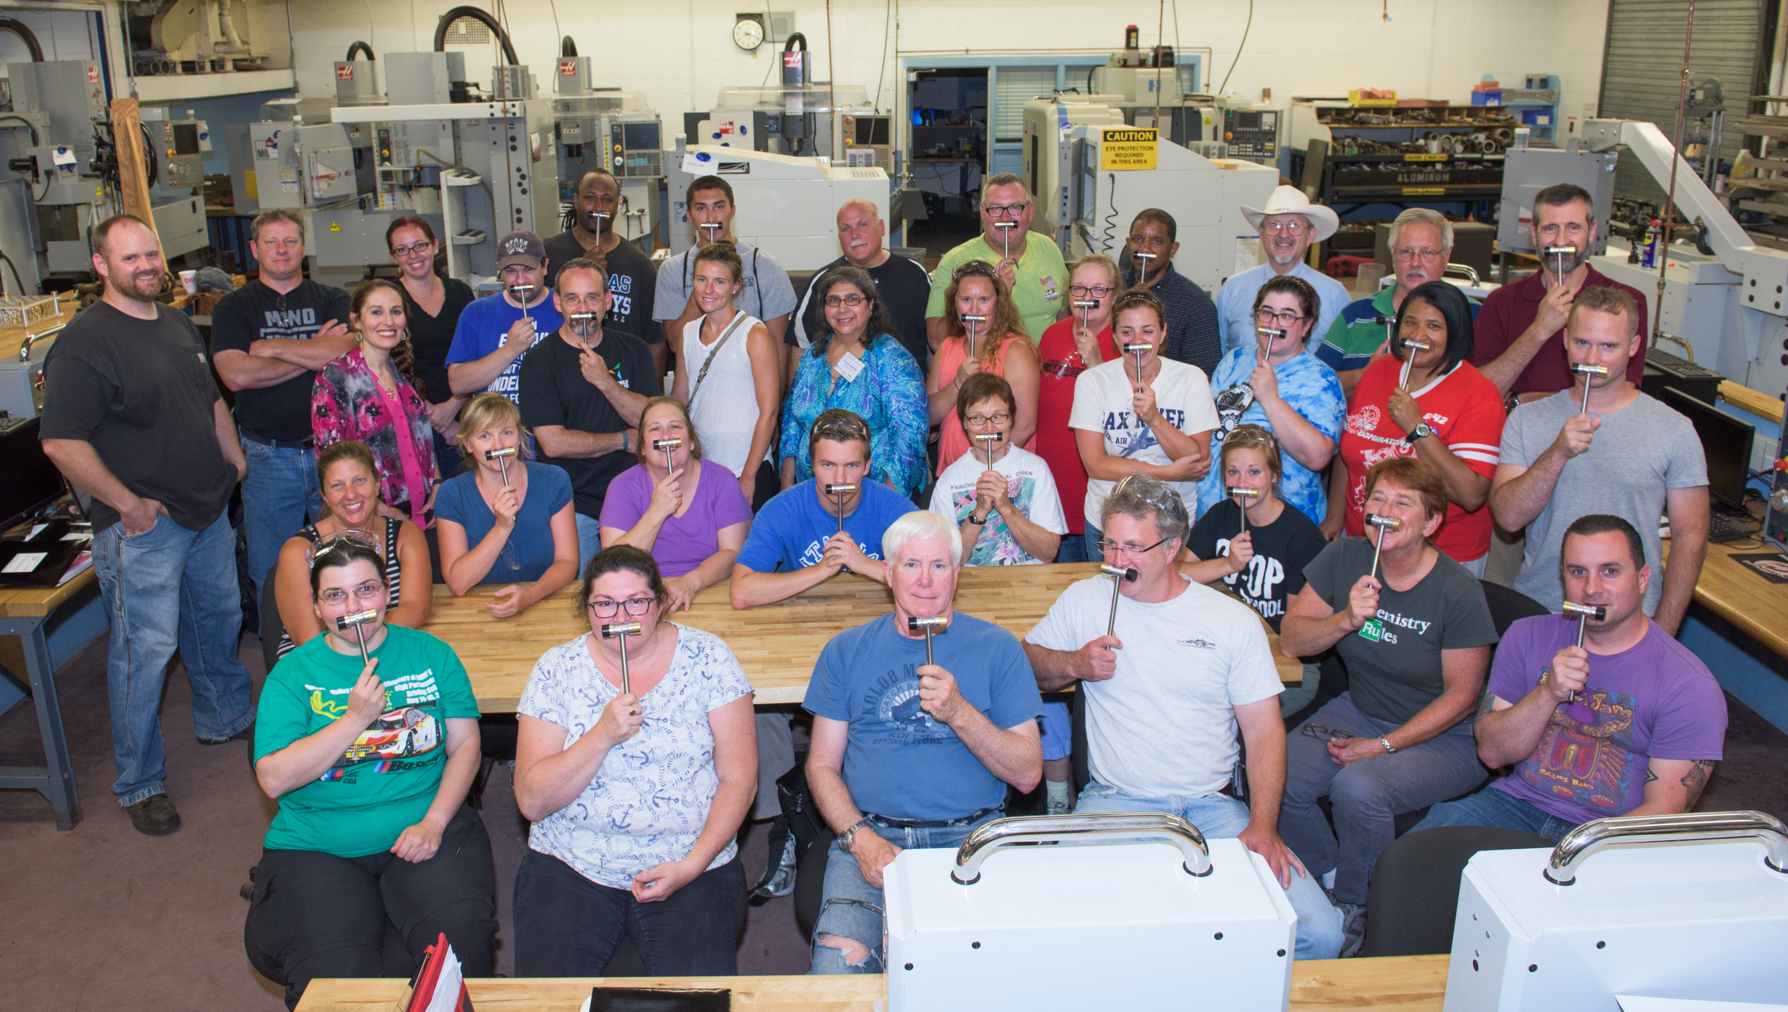
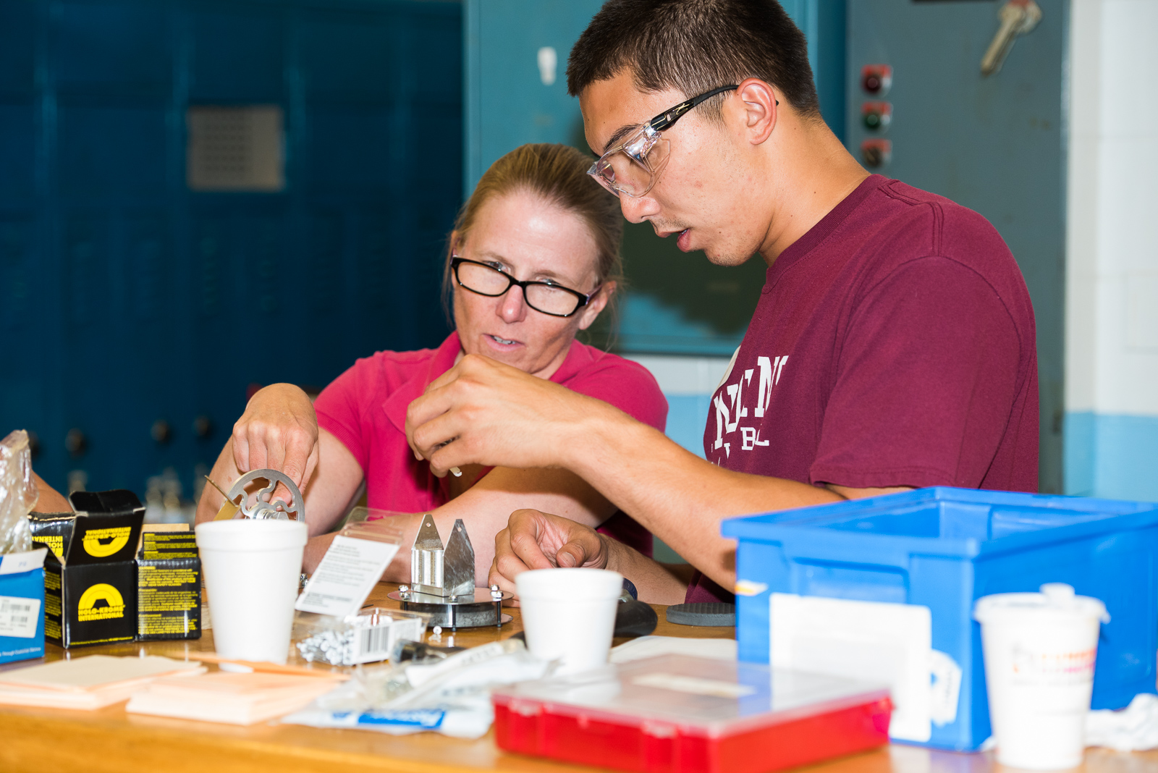
Materials & Manufacturing Summer Teachers’ Institute (MMSTI)
NSF DMR-1119826
2018
Center for Research on Interface Structures and Phenomena
Yale University & Southern Connecticut State University
The Materials and Manufacturing Summer Teachers’ Institute is a school-to-career initiative that targets STEM skills instruction for grades 7-12 in the New Haven and Bridgeport Public Schools.
Three-day workshop designed to:
Connect educators with industry professionals to discuss major challenges and their potential solutions, adequately preparing students for the growing demands of a 21st century workforce.
Provide teachers first-hand knowledge of local manufacturing demands and connect these processes to the science curriculum to help teachers create lesson plans based on these industrial experiences.
Since its launch, 123 educators have participated in the MMSTI (66 female, 22 URM, 75 from urban school districts).
Teachers gained first hand experience on manufacturing equipment at Platt Technical HS, learning what skills their students need.
At MMSTI, teachers machined and assembled hammers, and they manufactured working Stirling Engines.
Notes:
This cooperative program is presented by the New Haven Manufacturers’ Association (NHMA), the Center for Research on Interface Structures and Phenomena (CRISP), Southern Connecticut State University, the Southern Connecticut Chapter of the ASM Materials Information Society, and Platt Technical High School in Milford, CT.
The institute was open to science teachers from New Haven, Bridgeport, and Waterbury urban school districts and was designed to acquaint teachers with how STEM skills can be applied in Connecticut’s manufacturing industries.
Teachers learned from industry professionals about their workforce needs and networked with fellow educators from across CT, CEOs of local companies, and members of the CT Department of Education.
Teachers had the opportunity to tour local manufacturing plants, then spent 2 days machining and manufacturing their own products.

