Slide 1
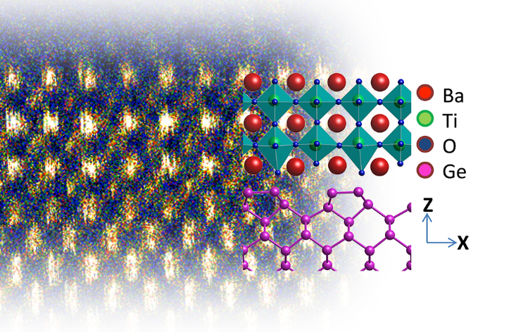
Revealing Hidden Phases in Materials
Strong interactions at the interface between a crystalline film and substrate can impart new structure to thin films.
Here, a germanium surface (purple atoms) squeezes a BaTiO₃ thin film above, revealing a hidden phase not seen in the bulk. The hidden phase of BaTiO₃ shows oxygen octahedra cages (shaded in aqua) alternating in size.
By combining theory, synchrotron x-ray diffraction, and electron microscopy, a new materials design approach has uncovered hidden traits of a material that can be expressed through articulated forces at an interface.
Cross section of a thin film of BaTiO₃ on Ge imaged using transmission electron microscopy.
Ismail-Beigi, Ahn, and Walker
D. Kumah, et al. Phys. Rev. Lett. 116, 106101, 2016
Notes:
A collaboration involving thin film growth at Yale and synchrotron x-ray diffraction and transmission electron microscopy at the national laboratories reveals a hidden phase in the functional oxide BaTiO₃. When BaTiO₃ is brought into contact with the surface of Ge, a surprising structure is observed. This structure, like bulk BaTiO₃, is found to be ferroelectric, but also has novel distortions of the oxygen octahedra surrounding the titanium atoms in the perovskite structure. These structural distortions are significant because they are thought to be responsible for determining a wide range of functional properties in the perovskites, such as enhanced superconductivity, novel magnetic properties, and electrical and thermal conductivity. Calculations of the interface structure using density functional theory agree with the experimental results involving hundreds of atoms. The work goes further by showing how this seemingly complex structure can be understood based on a simpler calculation of the elastic response of the lattice. The results have important implications for the materials genome design paradigm, suggesting that structural motifs with important physical properties can be catalogued for a wide variety of materials. Theorists and experimentalists alike can then go through this catalog and choose a materials combination that will result in a target structure that has the properties of interest to the researcher. This approach will accelerate the development of new magnets, superconductors, and conducting channels, and also provides a platform to explore fundamental questions in materials science.

