Slide 1
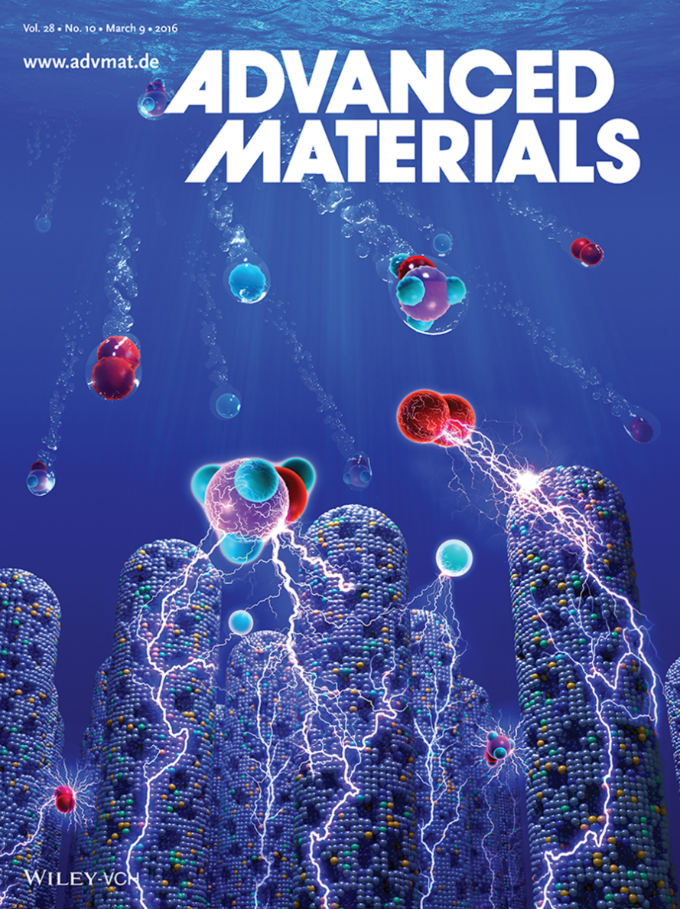
Electrocatalytic Surfaces Using
Bulk Metallic Glass Nanostructures
Metallic glass nanostructures provide a new platform for electrocatalytic applications. Several surface modification strategies that remove or add metal species (top images) improve the catalytic activity of metallic glass nanostructures. These strategies were demonstrated for three key electrocatalytic reactions important for renewable energy.
G. Doubek et al., Advanced Materials 28, 1940, 2016
Osuji, Schroers, and Taylor
Notes:
Professor André Taylor and co-workers demonstrate how desirable bulk metallic glass compositions can be obtained using a combinatorial approach. It is shown that these alloys can serve as a platform technology for a wide variety of electrochemical applications using a range of surface modification techniques. Electrochemical devices such as fuel cells, electrolyzers, lithium–air batteries, and pseudocapacitors are expected to play a major role in energy conversion/storage in the future.

