Slide 1
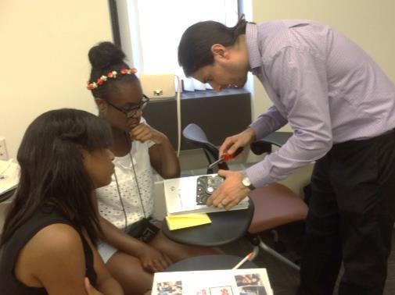
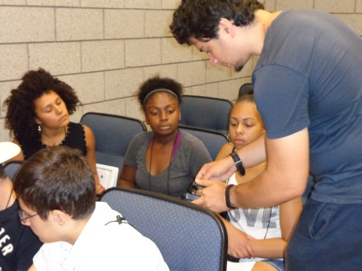
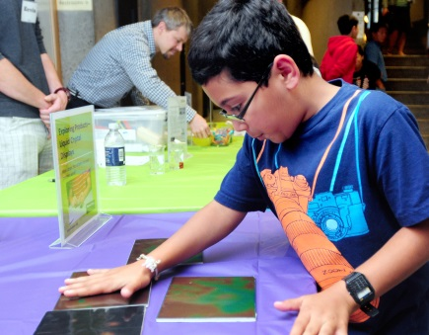
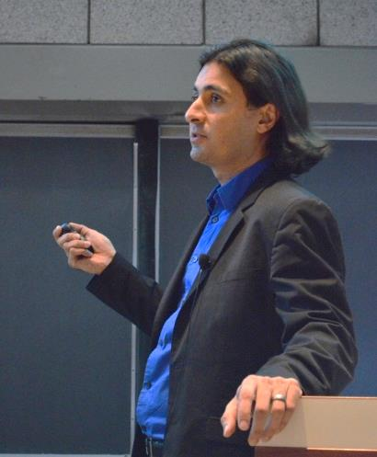
Public Lecture: “How Things Work: The Nano of Computers”
In September 2014, CRISP hosted a public lecture to school children and their parents entitled “How Things Work: The Nano of Computers” by Prof. Sohrab Ismail-Beigi, which described how common electronic devices such as computers and cell phones work. The event also featured hands-on demonstrations for participants that included electronic storage, light emitting devices, deconstructed computer processors, and memory devices.
Prof. Sohrab Ismail-Beigi
Visit CRISP EO online at crisp.yale.edu & crisp.southernct.edu
Notes:
This public lecture, held on September 23, 2014 in Davies Auditorium on Yale’s campus, reached more than 125 attendees (70 URM and 45 female). The hands-on demonstrations were created by CRISP and the Nanoscale Informal Science Education Network. Follow-on events at Yale included Pathways to Science two-week classes, which enrolled more than 37 high school students (16 URM, 21 female).

