Slide 1
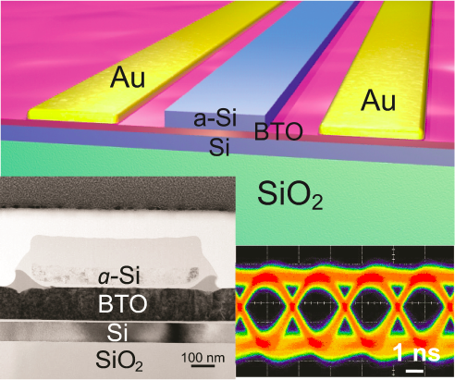
Heterogeneously integrated ferroelectric optical modulator on silicon with high Pockels’ coefficient
The collaboration among Hong Tang, Charles Ahn, and Fred Walker’s groups recently realized a new type of electro-optic modulator based on epitaxial ferroelectric BaTiO₃ on silicon. A very high Pockels’ coefficient, up to 213 pm/V, was demonstrated, a record value that is more than six times larger than found in commercial optical modulators based on lithium niobate. The monolithically integrated BaTiO₃ optical modulators show modulation bandwidth in the gigahertz regime, which is promising for broadband applications. Our work enables new opportunities to enhance silicon technology with novel materials developed in CRISP.
C. Xiong et al, Nano. Lett. 14, 1419 (2014)
H. Tang, F. Walker, C. Ahn (Yale University)
Center for Research on Interface Structures and Phenomena
Yale University | Southern Connecticut State University
NSF-MRSEC
DMR-1119826

