Slide 1
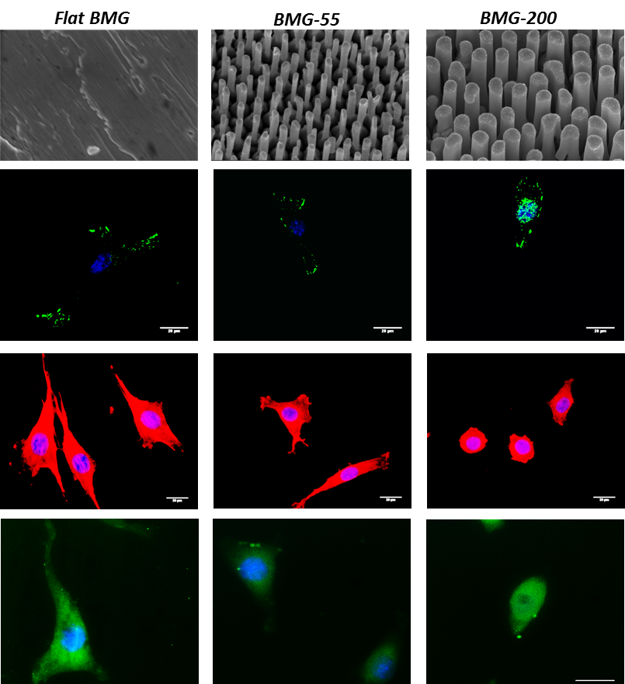
Engineering Cellular Response Using Nanopatterned Bulk Metallic Glass (BMG)
a)
Biomaterials implanted in the body evoke a “Foreign body response” which results in encapsulation of the material in a collagen-rich protein capsule. Fibroblast cells, which produce collagen, mediate this process that leads to biomaterial rejection / device failure in vivo. Surface nanotopography of BMGs can be used to engineer fibroblast-material interactions.
As shown here, varying nanopattern BMG nanopattern dimensions (a) leads to changes in the formation and distribution of protein complexes that mediate cell-material adhesion in fibroblasts (b). This leads to a decrease in intracellular levels of Rho-A GTPase, a protein which is involved in cell spreading and cell function. Fibroblasts grown on nanopatterned BMGs display restricted cell spreading (c) and produce significantly less collagen (d). Thus, nanopatterned BMGs can limit collagen production in fibroblasts and may provide a viable approach to control biomaterial rejection and increase implant lifetime.
b)
c)
d)
J. Padmanabhan, E. Kinser, M. Stalter, C. Duncan-Lewis, J. Balestrini, A. Sawyer, J. Schroers, T. Kyriakides, Engineering Cellular Response Using Nanopatterned Bulk Metallic Glass. ACS Nano 2014.
NSF-MRSEC
DMR-1119826
Center for Research on Interface Structures and Phenomena
Yale University | Southern Connecticut State University
Notes:
Technical details: 3T3 Fibroblasts are grown on control flat and nanopatterned BMGs for 24 hours and subsequently analyzed for morphology, focal adhesion formation, and collagen production using immunofluorescence staining. These experiments shed light on the molecular mechanisms that underlie cell-nanotopography interactions.
(A) Scanning electron micrographs of representative fabricated flat and nanopatterned BMGs with feature sizes of 55 nm (BMG-55) and 200nm (BMG-200). (B) Representative images of fluorescently labeled paxillin (green) and cell nuclei using DAPI (blue) in 3T3 fibroblast cells grown for 24 h on BMGs. (C) Representative image of 3T3 fibroblasts, grown on BMGs for 24 h. Cells are stained for F-actin (red) and nucleus (blue).. (D) Representative images of 3T3 fibroblasts fluorescently labeled for collagen I (green) and DAPI (blue).
Education/Outreach: The Kyriakides Lab is committed to promoting STEM research and hosts undergraduate students as a part of the CRISP REU research program each summer. Christopher Duncan-Lewis is one such undergraduate student, who is a co-author in the highlighted manuscript.

